Slide 1
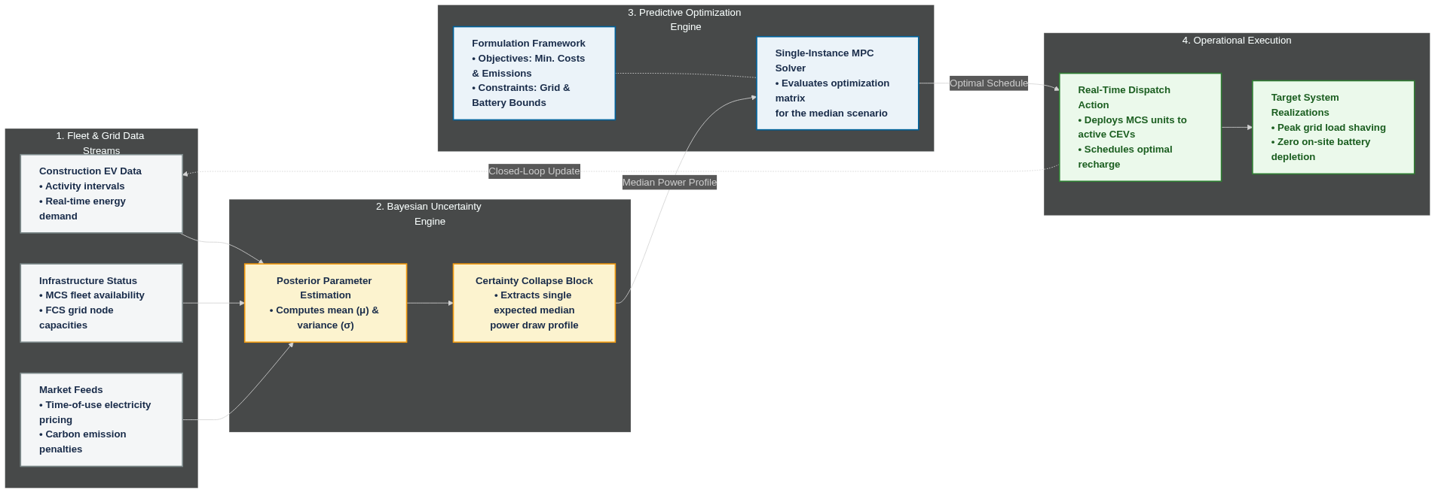
Next Steps- Uncertainty-Aware Dispatch Optimization (MPC)
Approach 1: Deterministic Certainty-Equivalent MPC
Pros | Cons
Computationally fast for real-time edge execution. Simple to implement and tune. | Vulnerable to unexpected power spikes (edge cases). Purely reactive (fixes errors after they happen).
Prevents on-site battery depletion and stabilizes the grid under real-world power uncertainty.

Slide 2
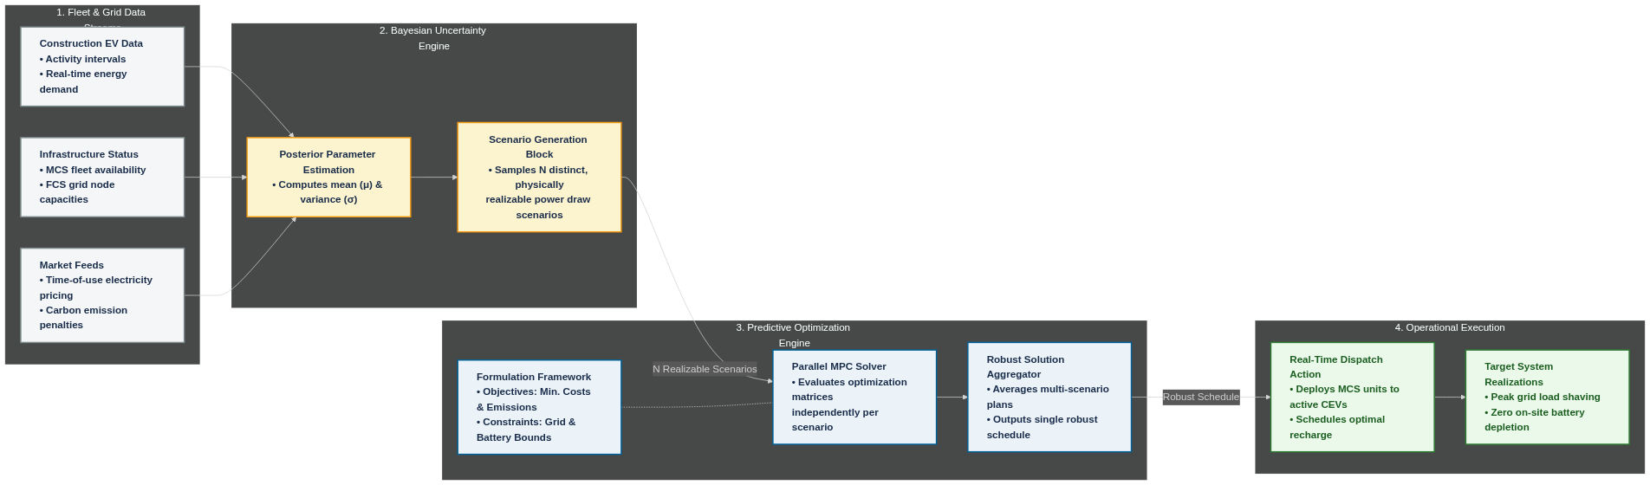
Next Steps- Uncertainty-Aware Dispatch Optimization (MPC)
Approach 2: Scenario-Based Stochastic MPC
Pros | Cons
Proactively prevents battery deaths and grid violations. Highly robust to unpredictable worksite behavior. | Computationally expensive for real-time hardware. Requires complex scenario-reduction math to work.
Prevents on-site battery depletion and stabilizes the grid under real-world power uncertainty.

